Slide 1


HR ANALYSIS
Workforce, Performance, and Attrition Insights

Slide 2


Presented by
Nada H Youssef
Zaher Nassif
Under Supervision
of
Eng. Ahmed Samir
Track: Data Analyst specialist
Code: CAI_DAT1_G2

Slide 3
Overview
This project delivers strategic workforce insights across demographics, hiring, attrition, performance, and promotion readiness.
Using Excel, SQL, Python, and Tableau, we analyzed employee behavior, identified retention risk areas, and built predictive models for future workforce needs.
The final interactive dashboards provide actionable, data-driven insights to support HR decision-making, workforce planning, and talent management.

Slide 4
Objectives:
Understand workforce composition
Analyze performance & attrition patterns
Identify high-risk employees
Suggest data-driven HR interventions
Significance:
Improve retention & productivity
Fair salary & promotion policies
Data-driven decision making

Slide 5
Introduction to Dataset
Data Cleaning and transformation
Exploratory Data Analysis
Data Visualisation
Predictive Analysis
Recommendations

Slide 6
Introduction to Dataset
Employees
Performance
1,470 employees, 23 Columns
Key Variables: Demographics, Job-Information, Compensation, and Attrition
6,709 reviews, 11 Columns
reviews and satisfaction ratings
Additional Tables
Rating Mapping
Satisfaction Level Mapping
Education Level Mapping

Slide 7
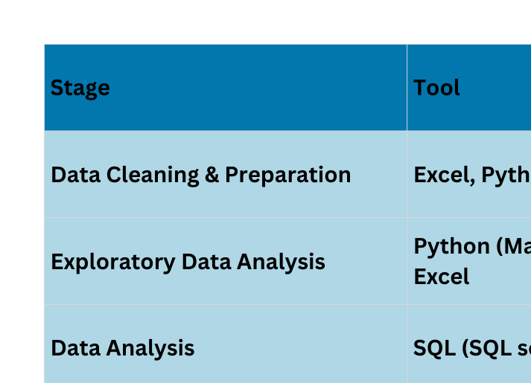
Introduction to Dataset
Tools Used

Slide 8
Introduction to Dataset
Data Cleaning and transformation
Exploratory Data Analysis
Data Visualisation
Predictive Analysis
Recommendations

Slide 9
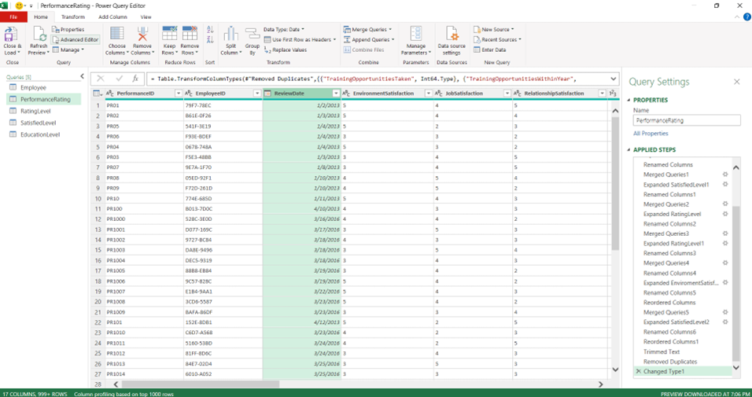
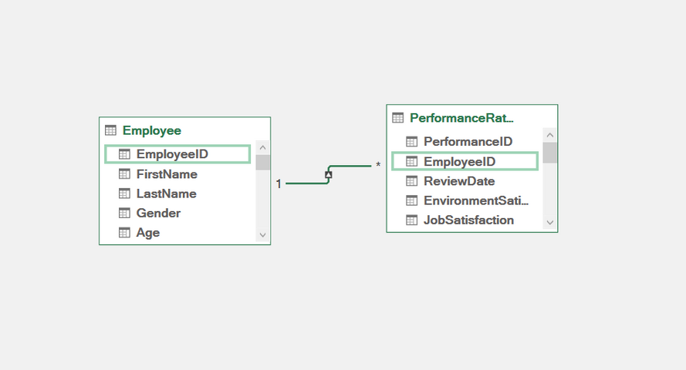
Data Cleaning and transformation
Cleaning by Excel (Query)
Denormalization
1
2
Remove duplicates, trim spaces, normalize text
Merging the mapping tables and
keeping 2 tables for analysis

Slide 10
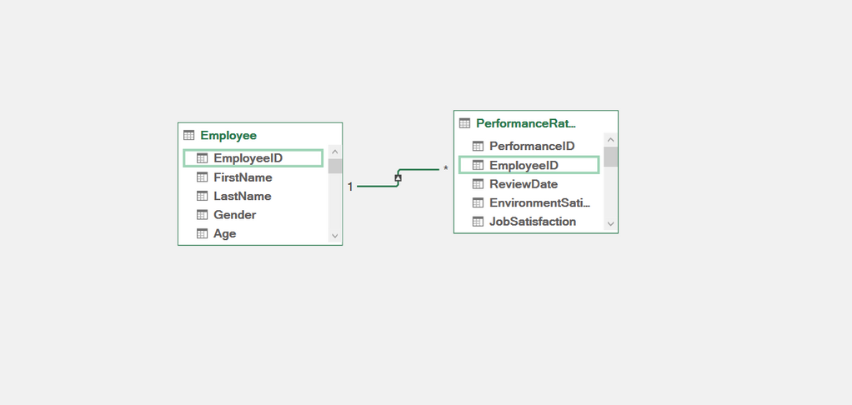
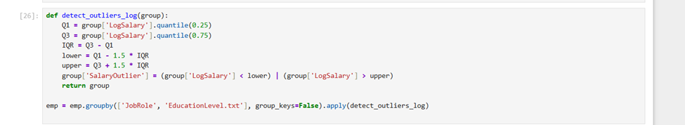
Data Cleaning and transformation
Cleaning by Excel (Query)
Denormalization
Further Cleaning in Python
1
2
3
Merging the mapping tables and
keeping 2 tables for analysis
Remove duplicates, trim spaces, normalize text
Handling Salary Outliers

Slide 11
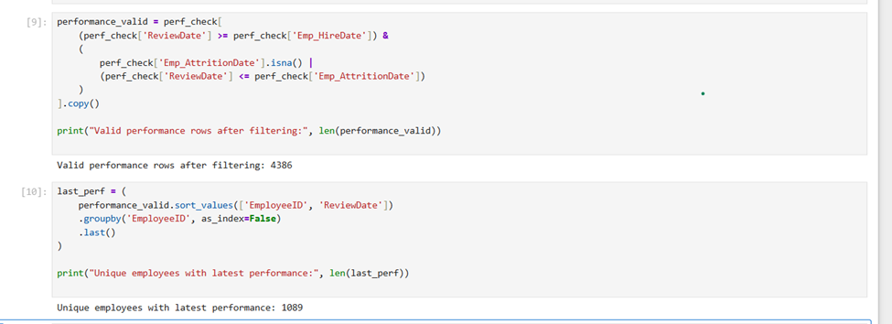
Data Cleaning and transformation
Denormalization
Further Cleaning in Python
Performance Cleaning
2
3
4
Merging the mapping tables and
keeping 2 tables for analysis
Handling Salary Outliers
Review date validation, dropped

Slide 12
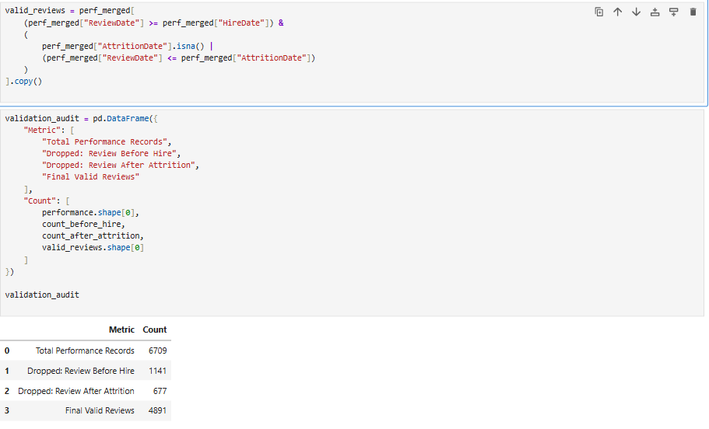
Data Cleaning and transformation
Further Cleaning in Python
Performance Cleaning
Last Performance merged
3
4
5
Handling Salary Outliers
Review date validation, dropped
Last review extracted and merged

Slide 13
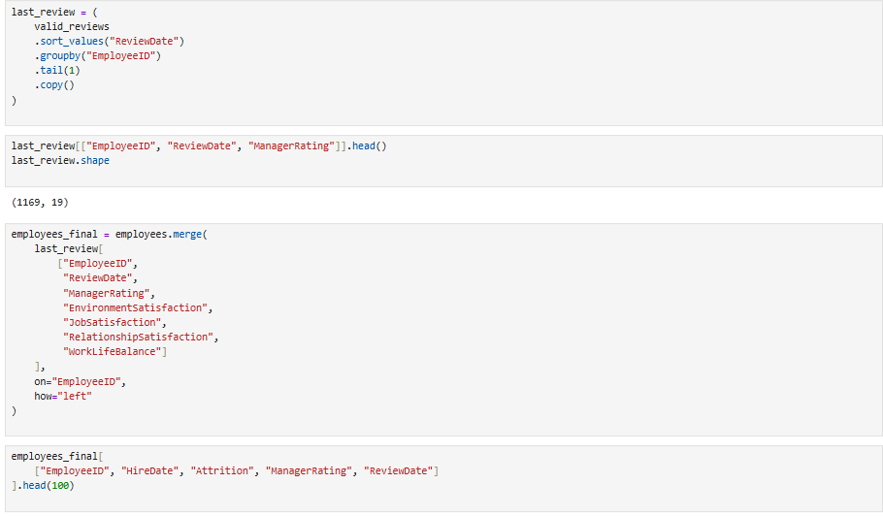
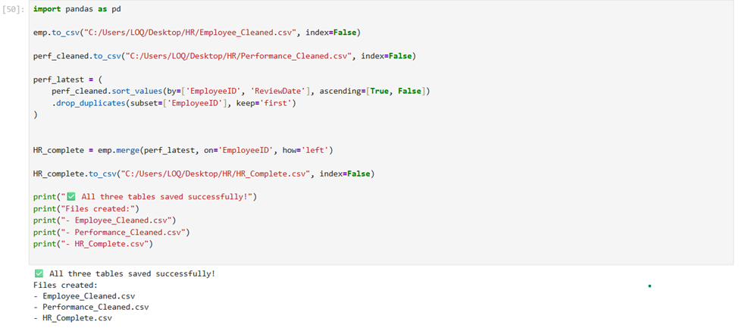
Data Cleaning and transformation
Performance Cleaning
Last Performance merged
Files exported as CSV for visualisation
4
5
6
Review date validation, dropped
Last review extracted and merged
Complete HR Data file, Valid performance file

Slide 14
Data Cleaning and transformation
Last Performance merged
Files exported as CSV for visualisation
5
Last review extracted and merged
Complete HR Data file, Valid performance file

Slide 15

Data Cleaning and transformation
Files exported as CSV for visualisation
6
Complete HR Data file, Valid performance file

Slide 16
Introduction to Dataset
Data Cleaning and transformation
Exploratory Data Analysis
Data Visualisation
Predictive Analysis
Recommendations

Slide 17




Exploratory Data Analysis
Employees
Performance
Salary
Attrition

Slide 18
Exploratory Data Analysis
Employees
What is the employees Demographics(Gender, Marital status, ethnicity)
How many employees are currently active vs left (current headcount)?
What is the total number of employees by department, job role, and location?
What is the gender and education level distribution across departments?
What is the average age, years at company per department?
How many employees were hired each year (trend of hiring over time)?
What is the average tenure (YearsAtCompany) by department and job role?
Which departments have the highest average experience?
Are higher education levels linked to longer retention?

Slide 19
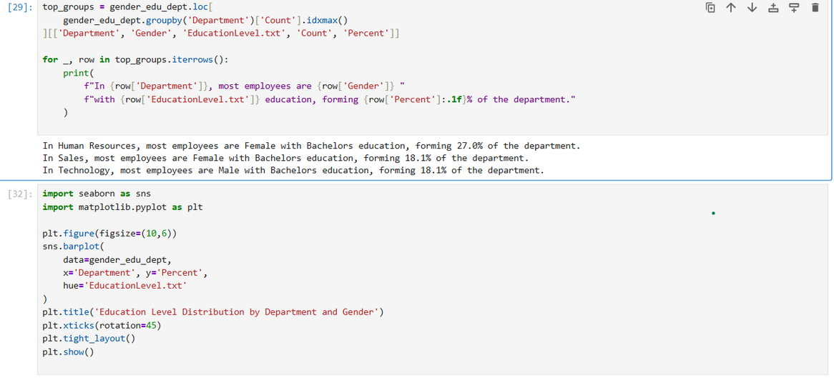
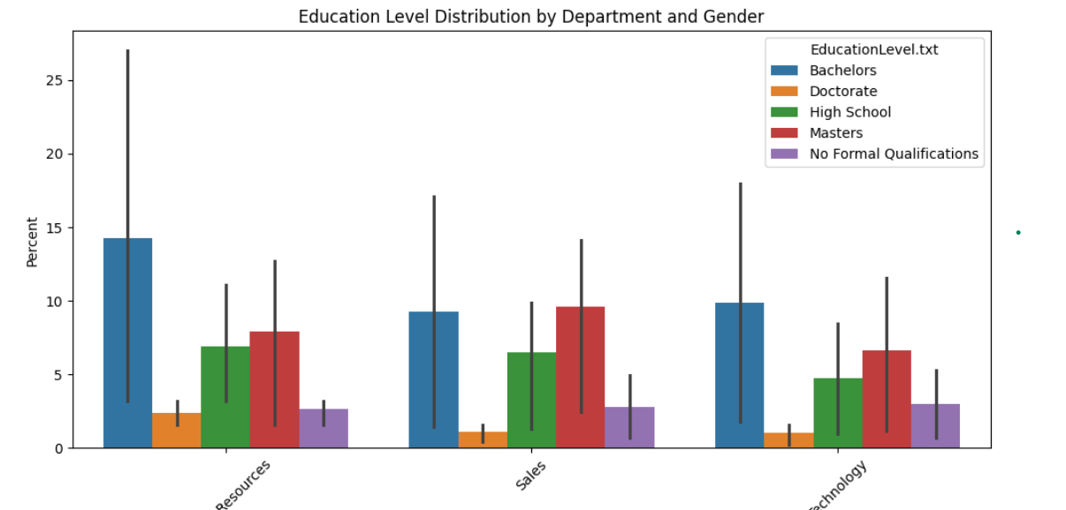
Exploratory Data Analysis
Employees

Slide 20
Exploratory Data Analysis
Employees
Performance
Salary
Attrition

Slide 21
Exploratory Data Analysis
Salary
What is the average salary per gender, ethnicity?
What is the average salary per department, Job role?
What is the average salary per Education level and field?
Does salary correlate with tenure or education?
Are salary gaps influencing attrition or dissatisfaction?
Do older employees earn more than peers with similar tenure?
Are higher education levels linked to higher pay?

Slide 22
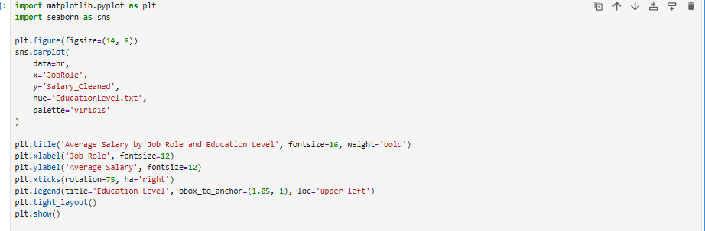
Exploratory Data Analysis
Salary

Slide 23
Exploratory Data Analysis
Employees
Performance
Salary
Attrition

Slide 24
Exploratory Data Analysis
Performance
What is the average Manager Rating by department, Job Role?
What is the average salary of top performers vs low performers?
what is the average Performance with Training?
what is the average Performance with Commute?
what is the average Performance with Overtime?
what is the average Performance with Work life balance, job satisfaction?
What is the average performance rating by tenure group (<1 yr, 1–5 yrs, >5 yrs)?
What is the average time since last performance review?
What percentage of employees improved or declined?

Slide 25
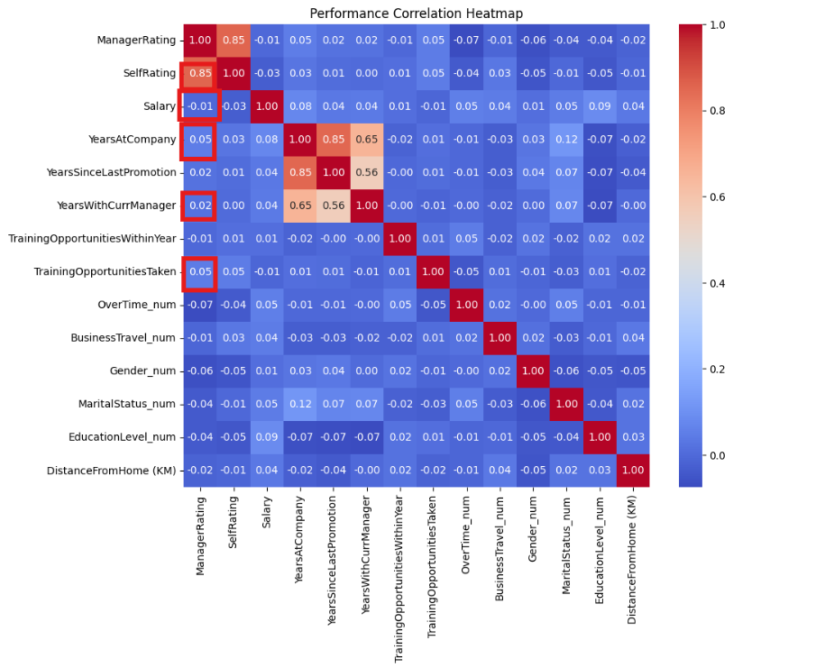
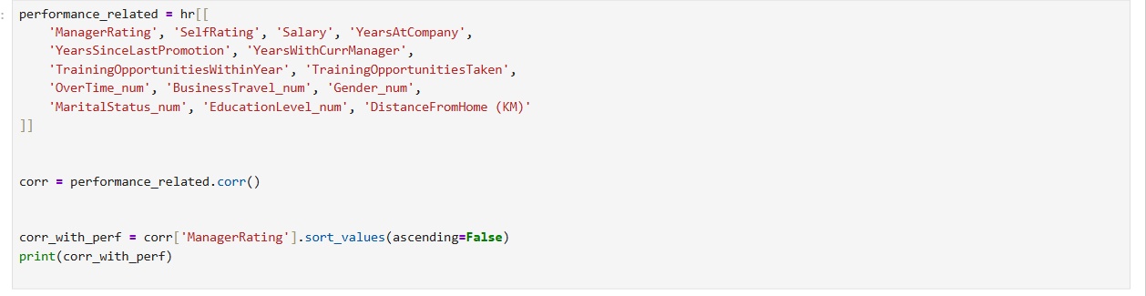
Exploratory Data Analysis
Performance

Slide 26
Exploratory Data Analysis
Employees
Performance
Salary
Attrition

Slide 27
Exploratory Data Analysis
Attrition
What is the overall attrition rate?
What is the attrition rate by Age, gender?
What is the attrition rate by department, job role?
What is the average tenure of employees who left vs stayed?
What is the attrition rate by salary band, education?
How does attrition vary by performance level?
Does working under certain managers increase attrition risk?
Does promotion frequency affect retention?

Slide 28
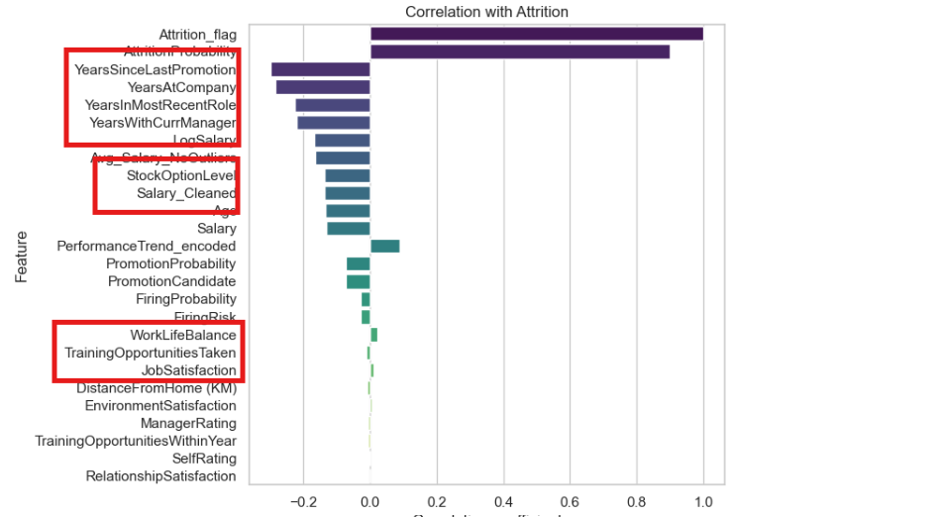
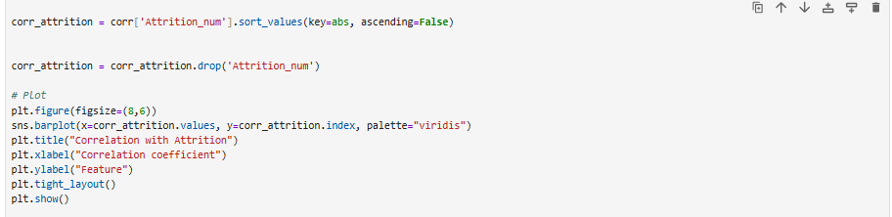
Exploratory Data Analysis
Attrition

Slide 29
Introduction to Dataset
Data Cleaning and transformation
Exploratory Data Analysis
Data Visualisation
Predictive Analysis
Recommendations

Slide 30
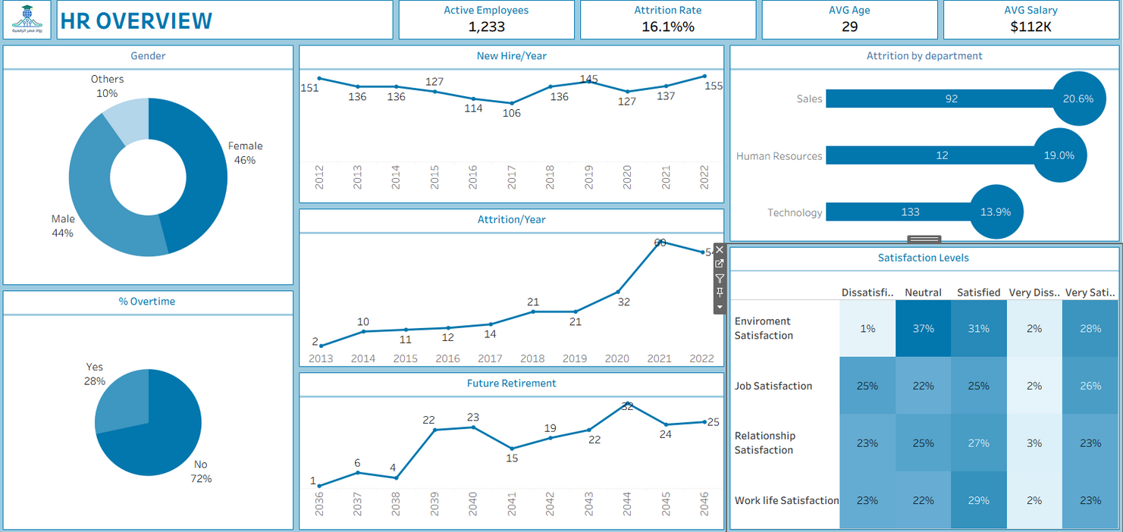
Data Visualisation

Slide 31
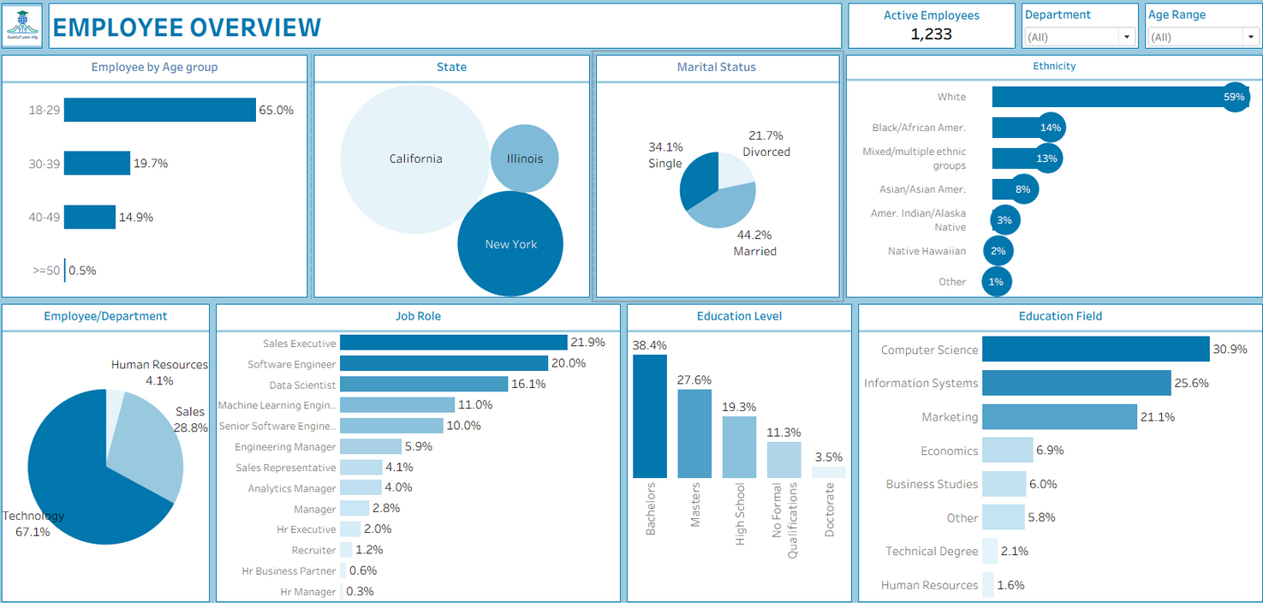
Data Visualisation

Slide 32
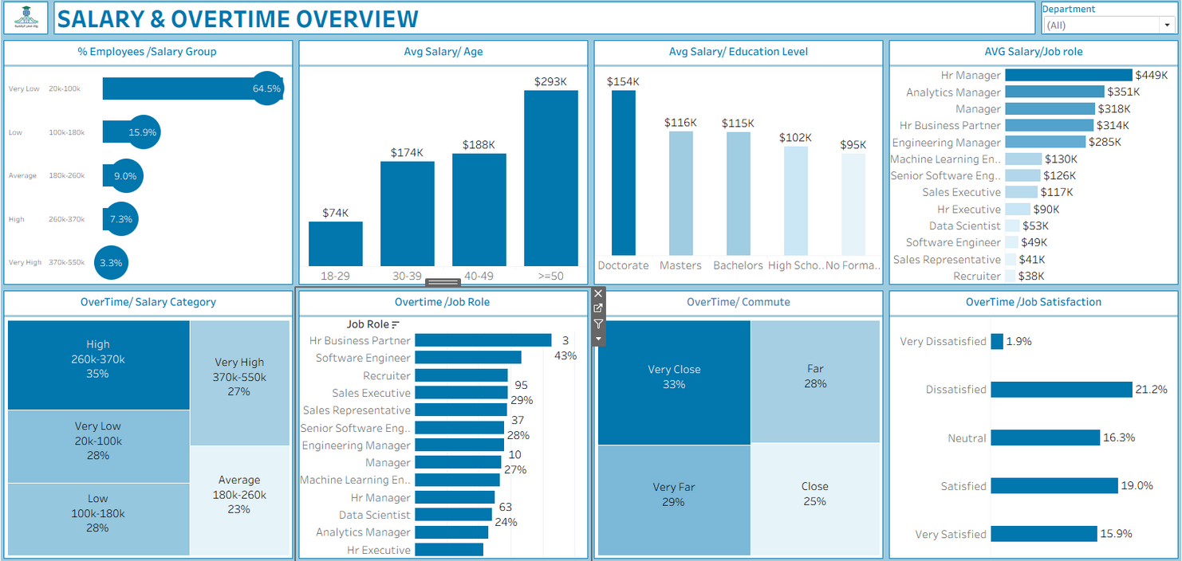
Data Visualisation

Slide 33
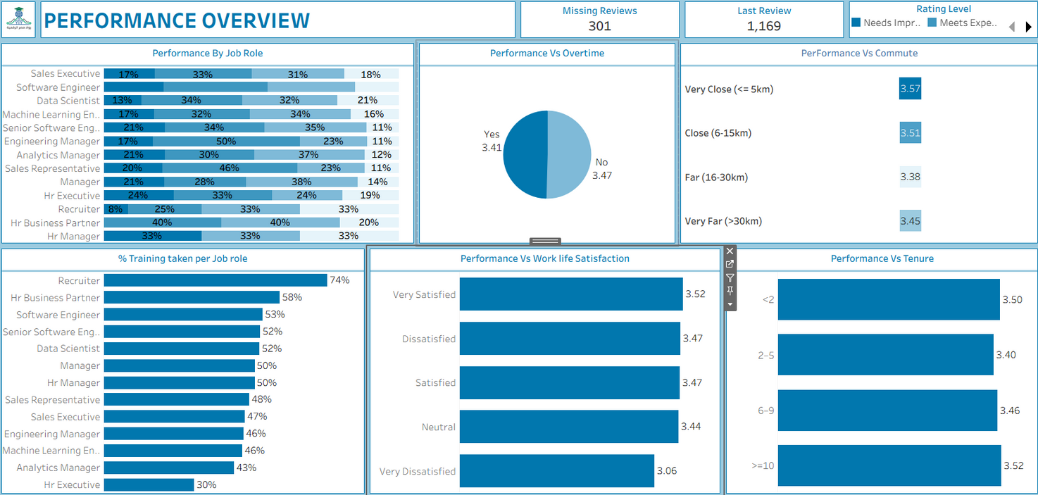
Data Visualisation

Slide 34
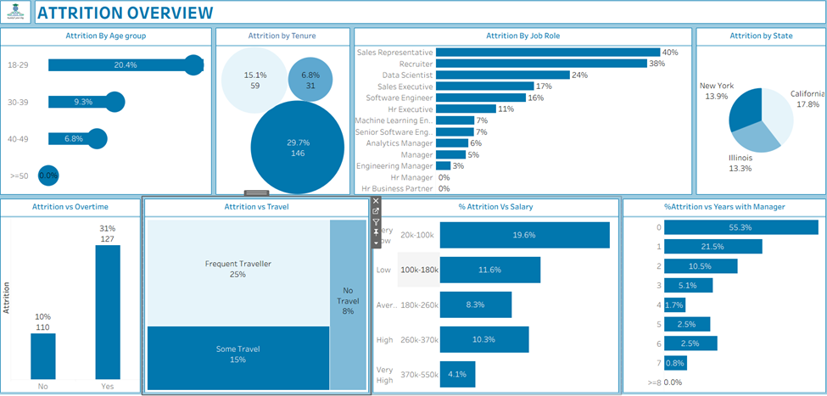
Data Visualisation

Slide 35
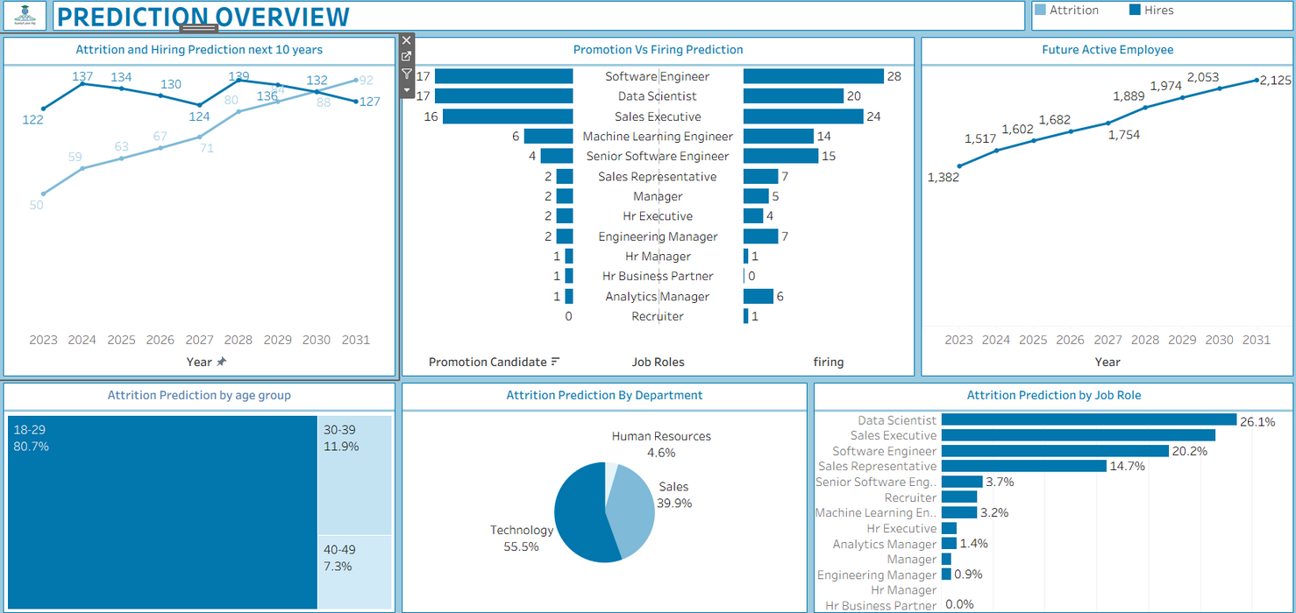
Data Visualisation

Slide 36
Introduction to Dataset
Data Cleaning and transformation
Exploratory Data Analysis
Data Visualisation
Predictive Analysis
Recommendations

Slide 37
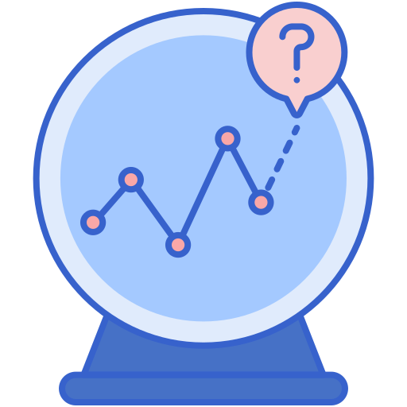
Predictive Analysis
This chapter applied machine learning and time-series forecasting to understand both current employee risks and future workforce trends.
Three predictive areas were analyzed:
attrition risk
promotion readiness
firing risk
Prophet-based forecasting for next decade.

Slide 38
Predictive Analysis
1. Attrition Prediction
Model 1 — Logistic Regression
Libraries used: sklearn (LogisticRegression, ColumnTransformer, OneHotEncoder, StandardScaler)
Approach: Full preprocessing pipeline including scaling and encoding categorical features.
Pros: Interpretable, straightforward implementation. 84% accurate.
Cons: Weak at capturing nonlinear interactions; low recall for high-risk employees.

Slide 39
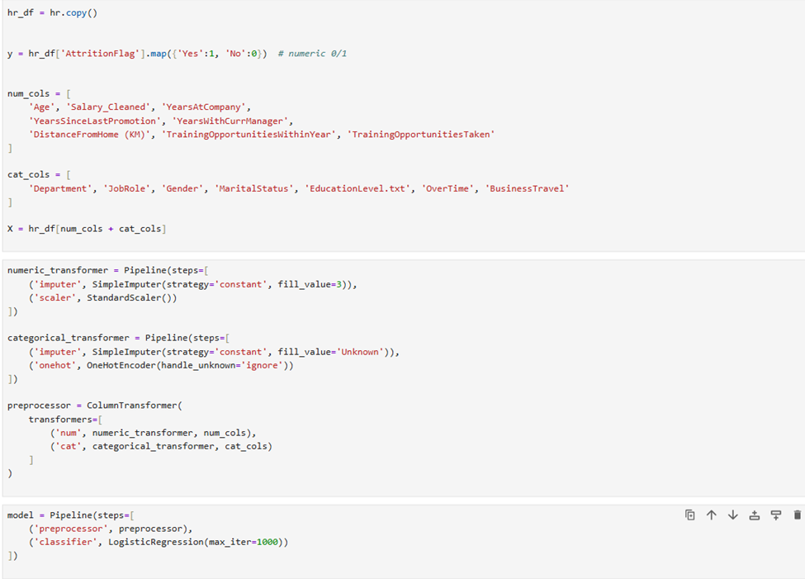
Predictive Analysis
1. Attrition Prediction

Slide 40
Predictive Analysis
1. Attrition Prediction
Model 2 — HistGradientBoostingClassifier (Recommended)
Libraries used: sklearn (HistGradientBoostingClassifier)
Approach: Handles missing values natively, captures nonlinear interactions.
Performance: Accuracy 87%, class 1 (attrition) recall = 0.43
Advantages:
Probabilities for individual employees are readily available.
No extensive preprocessing required.
Robust on tabular HR data.
Interpretation: Probabilities can be used to categorize employees into High, Medium, Low attrition risk.

Slide 41
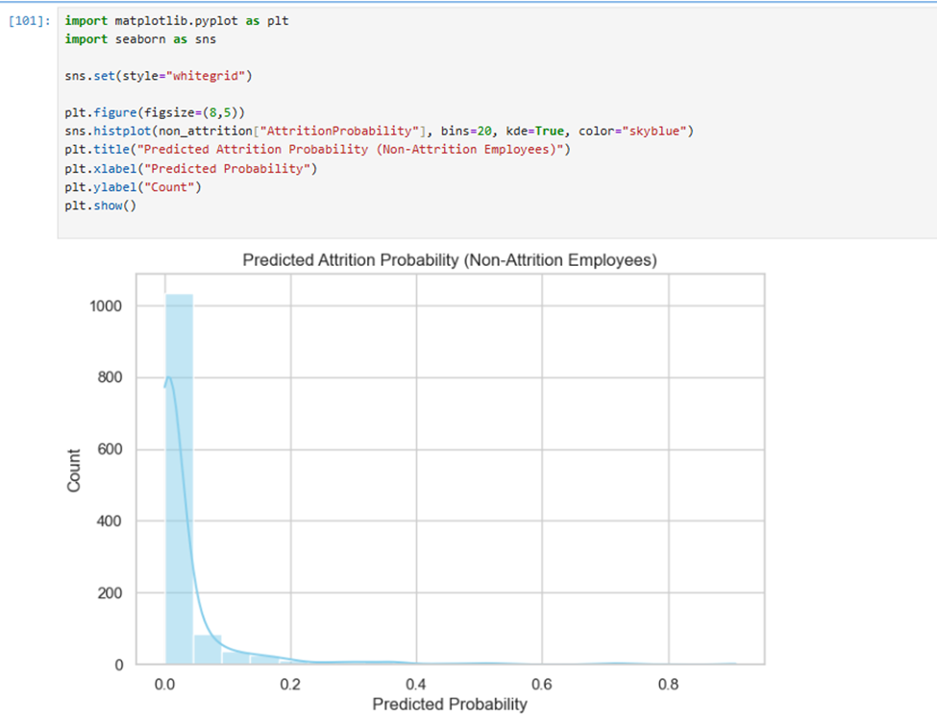
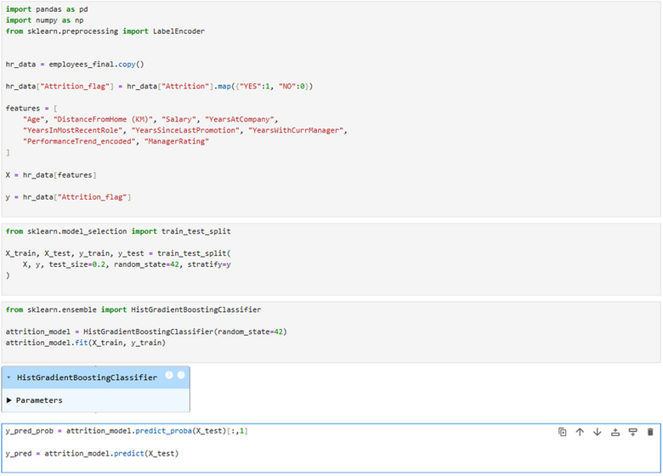
Predictive Analysis
1. Attrition Prediction

Slide 42
Predictive Analysis
1. Attrition Prediction
Model 3 — RandomForestClassifier
Libraries used: sklearn (RandomForestClassifier, LabelEncoder, SimpleImputer)
Approach: Manual preprocessing of categorical features and missing values.
Performance: Accuracy 89%, feature importance available for interpretability.
Top Predictors: Years Since Last Promotion and
Salary

Slide 43
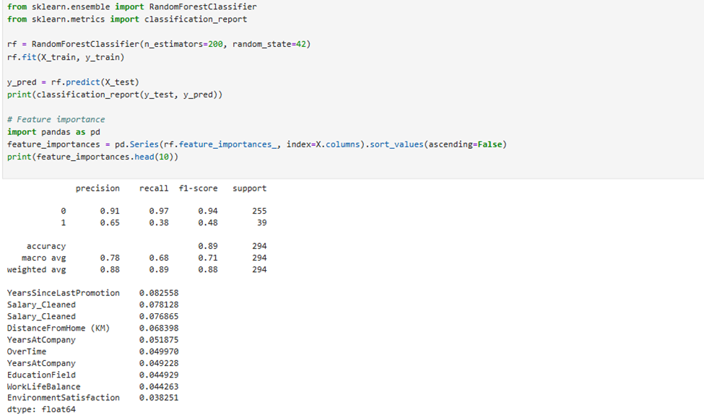
Predictive Analysis
1. Attrition Prediction

Slide 44
Predictive Analysis
1. Attrition Prediction
Insights
Employees more likely to leave:
Long tenure without promotion
Low salary
Long commute
High-risk departments: Technology, Sales
High-risk roles: Software Engineer, Senior Software Engineer, Data Scientist

Slide 45
Predictive Analysis
2. Promotion Prediction
Purpose: Identify employees likely to achieve high performance / promotion
Features: Tenure in role, performance trend, manager rating
Method: Simple model, LabelEncoding for performance trend
Result: Perfectly identifies promotion candidates
Insights:
HR can plan succession, training, and promotions
% DueForPromotion by department: HR 17.6%, Technology 14.5%, Sales 12.7%

Slide 46
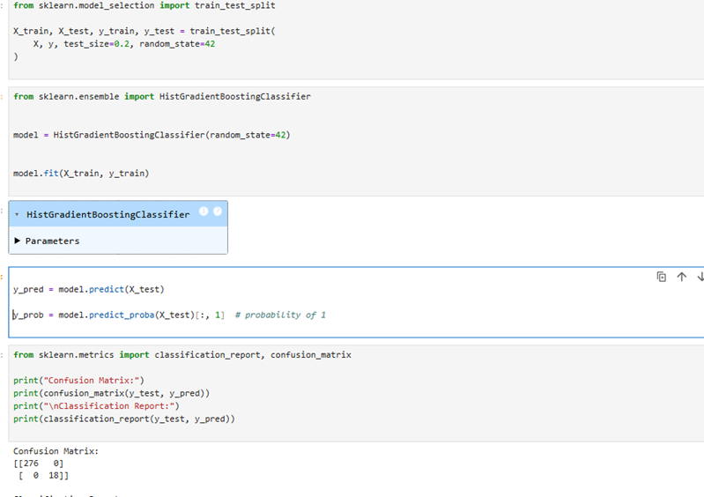
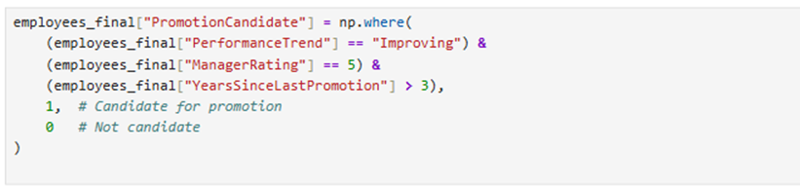
Predictive Analysis
2. Promotion Prediction

Slide 47
Predictive Analysis
3. Firing Risk Prediction
Purpose: Identify employees at risk of involuntary separation
Method: Same approach as promotion prediction (performance trend, last rating)
Insights:
Overall firing risk: 9.08%
High-risk departments: Sales 9.86%, Technology 8.95%, HR 5.88%
High-risk roles: Analytics Manager 14.3%, HR Executive 12%, Sales Rep 12%

Slide 48
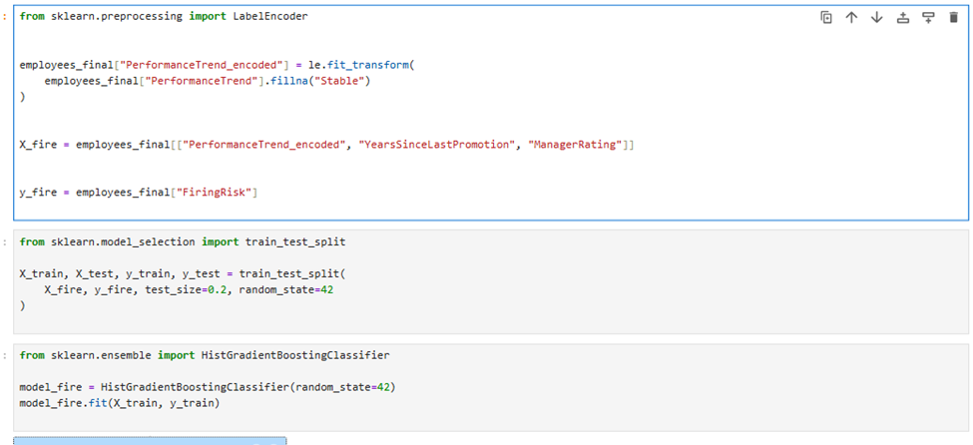
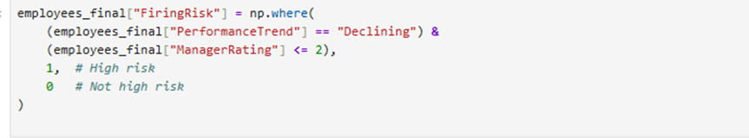
Predictive Analysis
3. Firing Risk Prediction

Slide 49
Predictive Analysis
4.Time-Series Forecasting (Prophet)
Forecast horizon: 10 years (2023–2032)
Metrics predicted:
• Hires
• Exits
• Active Employees
• Attrition Rate
Key Forecast Insights
Active employees expected to keep increasing steadily.
Exits projected to rise gradually over time.
Attrition rate fluctuates but spikes around 2028.
Hires remain stable with small variations year to year.

Slide 50
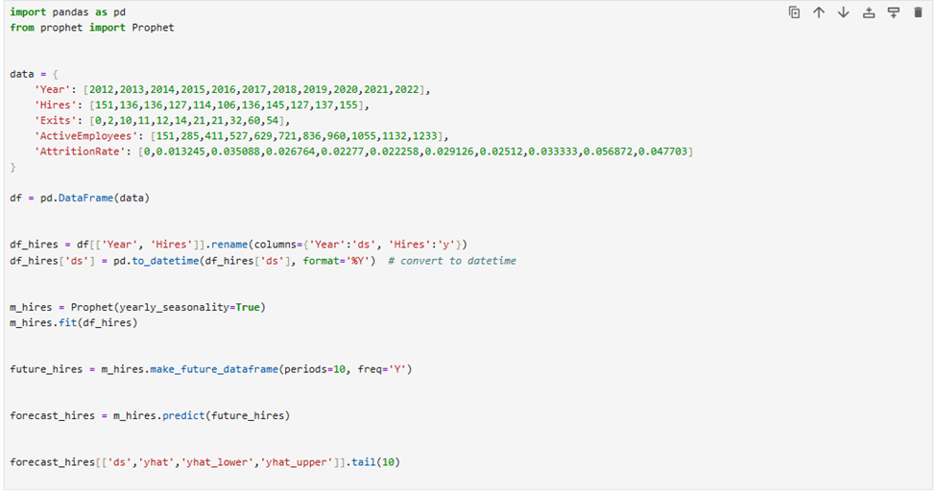
Predictive Analysis

Slide 51
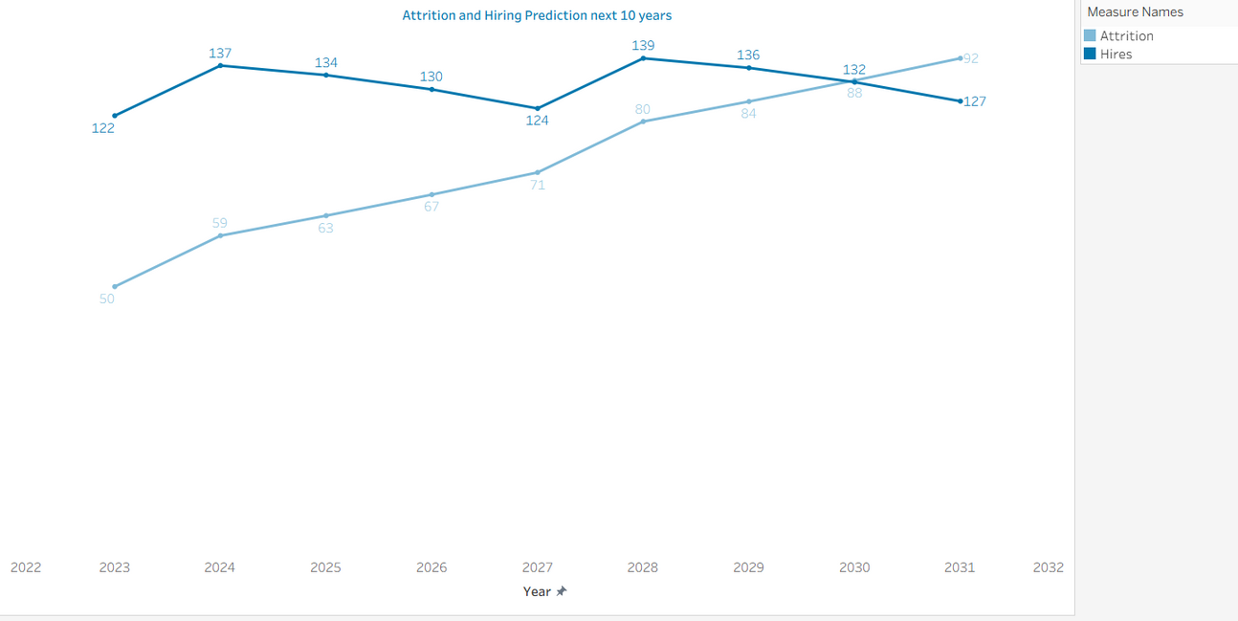
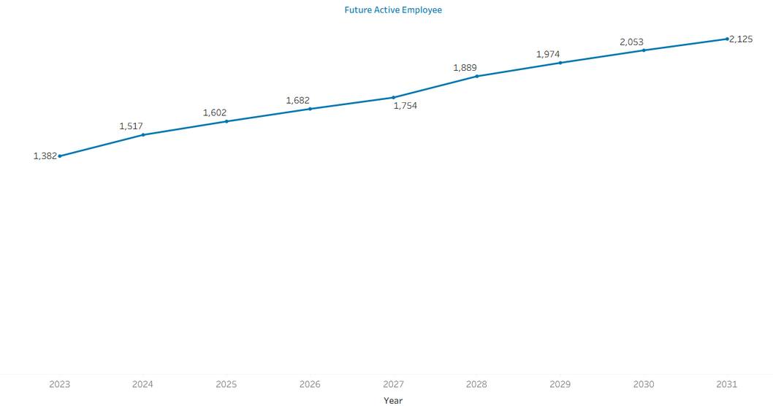
Predictive Analysis

Slide 52
Introduction to Dataset
Data Cleaning and transformation
Exploratory Data Analysis
Data Visualisation
Predictive Analysis
Recommendations

Slide 53
Recommendations
Attrition – Target High-Risk Employees
Focus on employees with:
Long tenure without promotions
Low salaries
Long commuting distances
Use HistGradientBoostingClassifier to flag high-risk employees
Implement retention programs: mentoring, career path clarity
Department focus: Technology & Sales
High-risk roles: Software Engineer, Senior Software Engineer, Data Scientist

Slide 54
Recommendations
Attrition – Retention & Compensation
Mentoring programs for early-career employees (<2 years)
Clear succession planning to motivate employees
Review salary structures → reward top performers
Consider performance-based bonuses or promotions
Flexible work options → remote/flexible hours for high-commute employees
Monitor overtime trends to prevent burnout

Slide 55
Recommendations
Performance
Leverage Training: Focus on measurable performance improvements
Track effectiveness via performance trends & manager ratings
Feedback & Recognition: Regular feedback, recognize high performers early
Promotion Readiness: Use models to identify high-potential employees
Transparent & timely promotions → boost motivation
Ensure workload balance to maintain performance

Slide 56
Recommendations
Firing Risk
Identify employees at risk of involuntary separation using prediction models
Early interventions: targeted coaching, mentoring, development plans
Combine firing risk predictions with attrition & promotion insights
Enables holistic workforce stability planning

Slide 57
Recommendations
Work-Life Balance (WLB)
Monitor WLB scores regularly
Address workload imbalances → reduce burnout risk
Flexible work options & reasonable hours for high-pressure roles
Encourage supportive policies → enhance retention & productivity

Slide 58
Recommendations
Short Term
Intermediate
Flag high-risk employees using predictive models
Implement mentoring, workload adjustments, flexible work options
Adjust salary bands for high-risk roles
Roll out structured performance improvement programs & training
Formalize promotion readiness & career path clarity
Expand work-life balance initiatives, monitor progress
Long term
Integrate employee-level risk predictions with organizational-level workforce forecasts for strategic planning.
Continuously refine salary bands, promotion policies, and retention programs based on predictive insights and attrition trends.
Establish a sustainable culture of performance management, engagement, and proactive risk mitigation across all departments.

Slide 60
Conclusion
This project demonstrates the transformative value of HR analytics in converting raw workforce data into actionable insights.
By linking attrition, firing risk, promotion readiness, performance, compensation, and work-life balance, organizations can make informed decisions to enhance employee engagement, retention, and productivity.
The findings provide a robust foundation for both operational HR management and strategic workforce planning, enabling proactive interventions that support a stable, high-performing, and motivated workforce.

Slide 61



THANK YOU!

